Slide 1
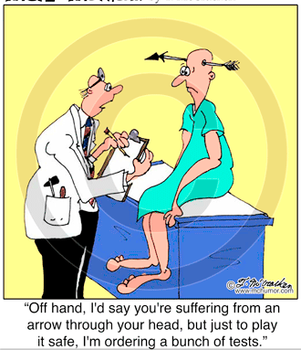
Overdiagnosis “winding back the harms of too much medicine”
Dr Jim huddy
JUNe 22

Slide 2
me
GP 2 days a week, Perranporth, Cornwall
Endoscopist 1.5 days a week Royal Cornwall Hospital
CCG lead for chronic pain
Chronic pain in Cornwall 5 year plan

Slide 3
PREVENTING OVERDIAGNOSIS INTERNATIONAL CONFERENCE
“WINDING BACK THE HARMS OF TOO MUCH MEDICINE”
FIRST EVER INTERNATIONAL CONFERENCE
SEPTEMBER 2013
Dartmouth College, Hanover
New Hampshire, USA
2.5 day event

Slide 4
OVERDIAGNOSIS the basic premise
THE SICK “disease” THE HEALTHY
THE SYMPTOMATIC “illness” THE ASYMPTOMATIC
RISK BENEFIT RATIO WORSENS
INCREASING COSTS
INCREASING ENVIRONMENTAL IMPACT

Slide 5
OVERDIAGNOSIS definitions
“overdiagnosis” is an umbrella term which refers to
overmedicalisation
overtreatment
diagnosis creep
shifting thresholds
disease mongering
all processes helping to reclassify healthy people with mild problems or at low risk as sick
Notes:
Screening = classic example
The wider definition increasingly used as a buzz phrase

Slide 6
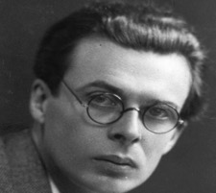
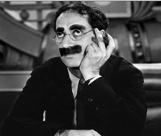
OVERDIAGNOSIS quotes
Aldous Huxley
"Medical science is making such remarkable progress that soon none of us will be well.”
GRAUCHO MARX
“I went in to see the Dr with a problem and I came out with a disease”
Notes:
Not a new concept
Huxley – in the 50s

Slide 7
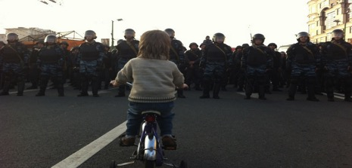
CAUSES OF OVERDIAGNOSIS
SYSTEM FACTORS
POLICY FACTORS
DOCTOR FACTORS
PATIENT FACTORS

Slide 8
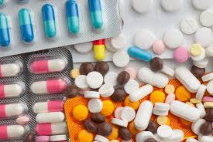
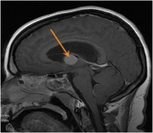
DRIVERS TO OVERDIAGNOSIS SYSTEM FACTORS
Pharma influence
Investigation too easy (tick box bloods) B12!!!
Publication bias
Duplication of investigations / referrals
Time pressures
Increasingly sensitive tests / incidentalomas
Private screening services

Slide 9
DRIVERS TO OVERDIAGNOSIS SYSTEM FACTORS
Adherence to GUIDELINES written by specialists
With conflicts of interest
Lack generalist representation
Government decisions (+/- evidence base)
QOF
Screening programs
Health reviews
Awareness campaigns / disease groups / charities
e.g. “Movember”

Slide 10
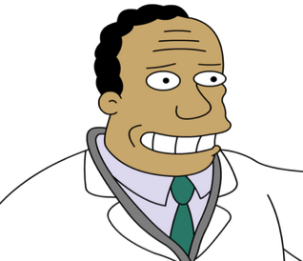
Drivers to overdiagnosis DOCTOR FACTORS
Conflict of interest
Academic
Financial
Personal
Departmental
Perceived need “to do something”
Fear of missed diagnosis / litigation
“better to do too much than too little”
Investigation > clinical skills
Over-testing e.g. junior Drs
Industry influence
Greed

Slide 11
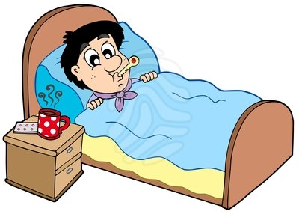
DRIVERS TO OVERDIAGNOSIS PATIENT FACTORS
FEAR from
Media influence
Awareness campaigns
Increasing medicalisation of “life”
Bereavement
Old age
Challenging behaviour in children
Libido
Menopause
Misunderstanding of potential harms of intervention
“Being taken seriously”
Belief that
investigation is part of treatment
more medicine is better medicine
knowledge of the unimportant is empowering

Slide 12
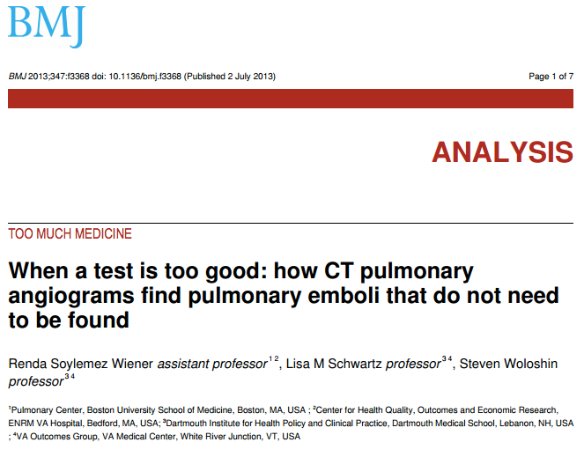
http://www.bmj.com/content/347/bmj.f3368.pdf%2Bhtml

Slide 13
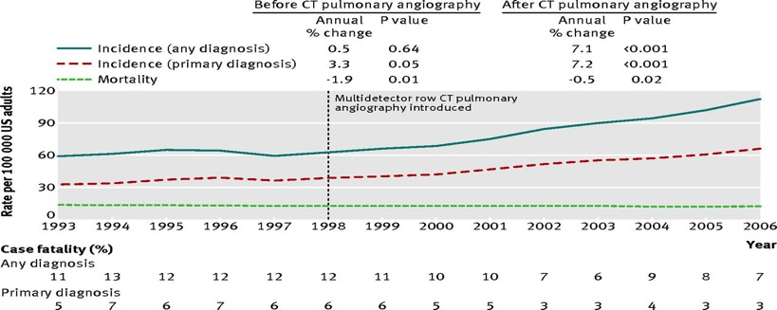
Incidence, mortality, and case fatality of pulmonary embolism in United States, 1993-2006.26.
©2013 by British Medical Journal Publishing Group
Wiener R S et al. BMJ 2013;347:bmj.f3368
Notes:
Incidence, mortality, and case fatality of pulmonary embolism in United States, 1993-2006.26

Slide 14
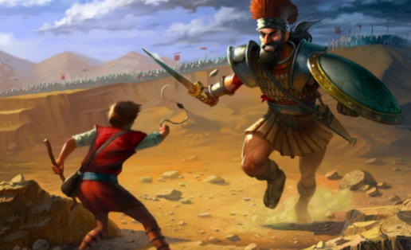
OVERDIAGNOSIS WHAT CAN WE DO?

Slide 15
My personal style **written in 2015**
Increasingly less investigations
Difference between specialist and generalist style
1 in 500 consultations in GP new cancer
Vast majority of patients in primary care are well
Use a watch and wait approach
Avoid tick box mentality
Consider risks of investigation
Don’t succumb to fear
LET THE PATIENT DECIDE

Slide 16
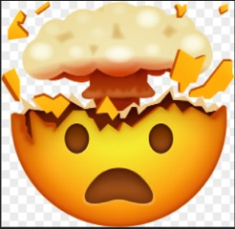
CASE EXAMPLE
48Y male fit and well
Consults JH for new onset “indigestion”
No alarm symptoms, stress in life, PPI watch and wait
Over next 4 months sees two colleagues not much done
Sees JH 5m later odynophagia nil else non 2ww OGD requested
10d late haematemesis – admitted – advanced oesophageal cancer
NHSE complaint – Investigation a bit like getting homework marked vs guidelines
Outcome – no maltreatment, some learning points, in house system changes
BUT lots of work lots of stress

Slide 17
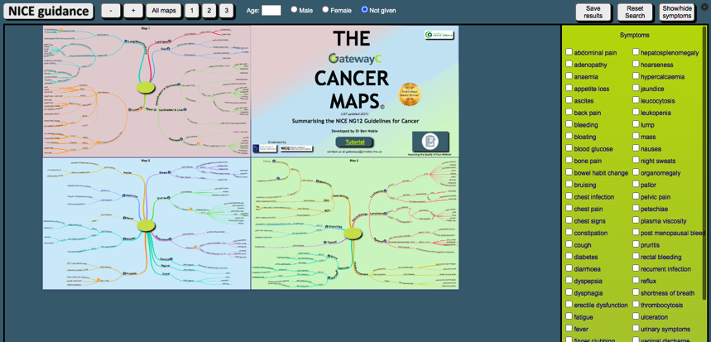
Could it be cancer? Just follow ng12

Slide 18
My personal style has it changed?
More guideline aware – self protection - reference in notes
If it could be cancer then “I advise” following NG12
PSA for example – much softer... We could test but here’s the risks do you really want to open that door?

Slide 19
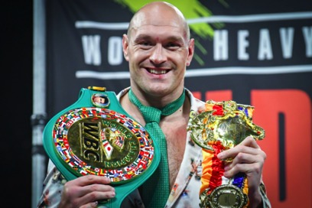
somatisation
81y male
I’ve known since joining
Perranporth 2007
World heavyweight champion of somatisation
Every consultation at least 3 symptoms
Loss of continuity – referrals, 2ww, anxiety, maybe gets worse
SOMATISATION + HEALTH ANXIETY + FIXED HEALTH BELIEFS

Slide 20
somatisation
BUT – he could get pathology... He will get pathology
CONTINUITY
TRUST + EXPLANATION
MANAGING UNCERTAINTY
SHARED DECISION MAKING
(assessing risk of complaint if late diagnosis??)

Slide 21
My personal style
History + examination
Range from the obviously functional to the obviously sinister
What might happen if we watch and wait?
What might happen if we investigate / treat
What are the possible outcomes and likelihoods of these different options
***Allow the patient to decide***

Slide 22
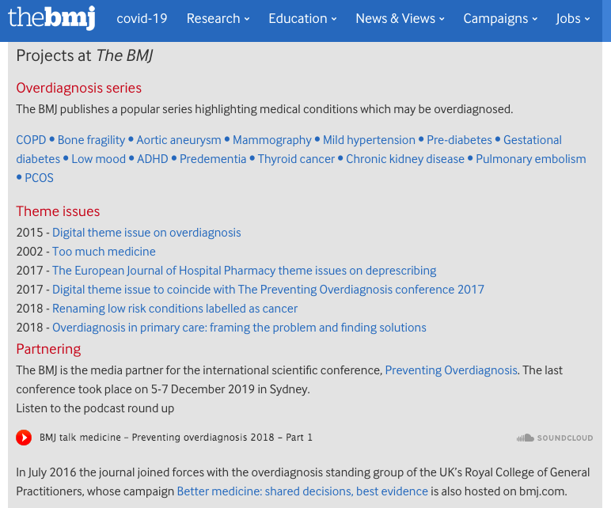

Slide 24
To conclude our best weapon

