Slide 1
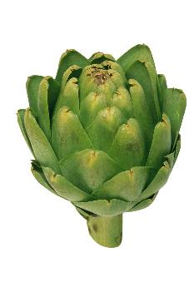
Vegetable of the Week:
Artichoke
Buy tinned and add on the side of any dish for some extra folic acid, vitamin C fiber and protein – Great on a pizza!!!
One Large Artichoke contains approx. 6g of dietary fiber – much more then a cup of prunes!
Artichoke Salad
Toss lettuce and a bell pepper with 1 tbsp of a vinaigrette – Homemade is best!
Cook the quinoa as per package instructions and drain your tinned chickpeas.
Top your salad with artichokes and a sprinkle of cheese.

Slide 2
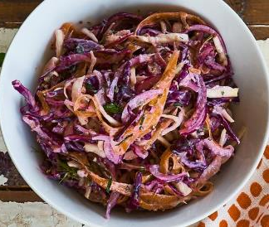
Vegetable of the Week: Cabbage
Cabbage is a vegetable which tastes great, really crunchy and is more nutritious than it looks!
A portion is:
54% of your daily intake for Vitamin C.
85% of your daily intake for Vitamin K.
More than 2g of fiber – Important for controlling blood glucose levels!
Quick & Easy Pickled Slaw – better alternative to coleslaw
Mix a spoonful of yoghurt, some lemon juice and mustard
Chop your cabbage (add carrot & onion if you’d like.
Leave for a few minutes for the flavours to mingle.

Slide 3
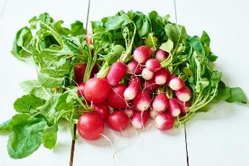
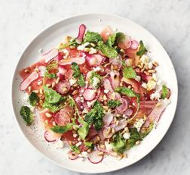
Vegetable of the Week: Radishes
Make a quick pickle
Chop the radishes
Mix in a bowl with a splash of red wine vinegar and olive oil
Leave for 10 minutes for the flavours to develop
Add to salads for a tangy crunch
Roasted Radishes
Chop off the leaves and half.
Place in a baking tray, drizzle with oil, ginger and black pepper.
Back at 180C for 10 minutes, then flip over and cook for a further 10 minutes.
This is a great low carbohydrate side dish to pair with your lunch or dinner.

