Slide 1
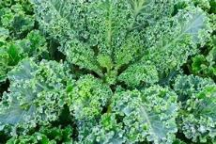
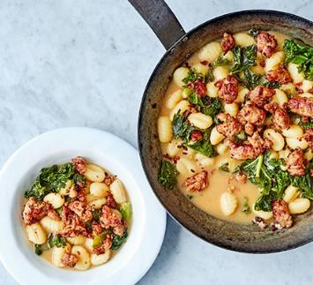
Vegetable of the Week:
Kale
Kale Crisps
Preheat the oven to 140C.
Cut up into smaller sections and remove tough stalks.
Mix with olive oil and your preferred seasoning.
Place on a baking tray and bake for 15 minutes.
Shake trays and bake for another 15 minutes until crisp.
An 80g portion of kale has 4x more vitamin C and 2x the amount of selenium then spinach. These are important for an effective immune system.
Gnocchi One-Pot
Heat oil in saucepan and squeeze the sausages from their skins into the pan to fry.
Cook until browned and then sprinkle in chili flakes & remove.
Add gnocchi into same pan then pour in 500ml of chicken stock. Leave for 3 mins until tender.
Add kale to the pan and leave for 2 minutes until wilted.
Plate up, sprinkle some cheese on top and season with black pepper.

