Slide 1

Omelette
Serves 2 people
Preparation time = 5 minutes Cooking time = 5 minutes
Shopping List:
Store Cupboard
1 Teaspoon of oil
Fresh
3 Eggs
30g Cheese
Equipment
Frying pan
Spatula
Cup or bowl
Fork
Cheese Grater

Slide 2
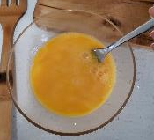


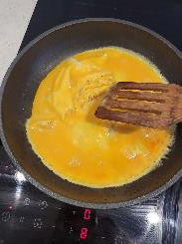
Method
Picture
Step 4 – Grate the cheese and sprinkle over the omelette
Picture
Step 1 – Crack eggs into cup or bowl and mix using a fork
Step 2 – Heat a teaspoon of oil over a medium heat and add the eggs
Step 5 – Use the spatula to fold the omelette in half, divide in 2 and serve
Step 3 – Use the spatula to gently pull the edges into the middle so it cooks evenly
Picture
Picture

