Slide 1
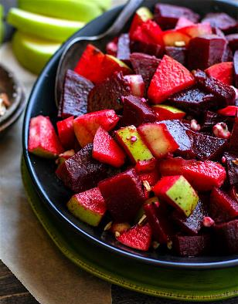
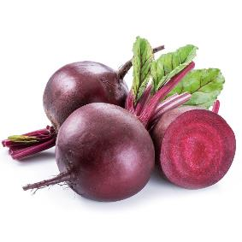
Vegetable of the Week: Beetroot
In season between June – October.
High in antioxidants. These help to remove potentially damaging compounds within the body.
Studies suggest it may help to increase blood flow, which could potentially help to lower blood pressure.
Rice with Beetroot & Apple Salsa
Boil rice for 20 minutes, then add green beans and cook for 5 mins more.
Drain the rice and beans.
Mix in flavorings, such as: spring onions, mint & lemon juice.
Dice beetroot & apple then mix, add in 1 tablespoon of balsamic vinegar.
If you don’t have balsamic vinegar, you can use a tablespoon of any dressing in your fridge.

