Slide 1
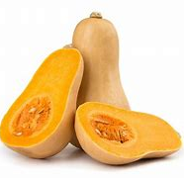
Vegetable of the Week: Butternut Squash
Loaded Butternut Squash
Heat oven to 200C.
Cut the squash in half and scoop out the seeds.
Rub with oil, sprinkle over chilli flakes, salt & pepper & bake for 30-40 mins.
Chop a courgette, pepper and onion, then add to a roasting tray with some oil. Bake for 20-25 minutes. Add cherry tomatoes and cook for another 10 minutes.
Once all cooked, arrange the vegetables in the squash halves. Add a sprinkle of cheese – a small amount of goat’s cheese works well!
Bake for 10 more minutes until the cheese has melted.
Season: June to November
High in beta-carotene which supports the immune system. Beta-carotene can be converted to vitamin A, which is important for eye health and cell renewal.

