Slide 1
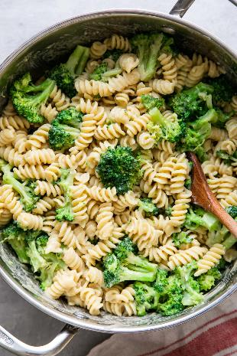
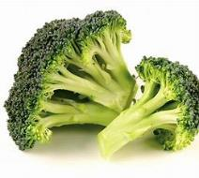
Vegetable of the Week: Broccoli
Broccoli Pasta
Fry the onion for 10 minutes until soft.
Squeeze the sausage meat from the casings into the pan and fry with the onion.
Add the garlic to the pan.
Boil the pasta, and halfway through, add the broccoli.
Once cooked, drain and add to the frying pan. Season with salt, pepper, lemon juice and chilli.
Serve with a sprinkle of cheese.
Season: June to December.
Rich in folate and Vitamin C.
80g portion of broccoli (2 spears)
counts towards 1 of your 5 a-day.
Full of fibre which supports the digestive process.
Consuming steamed broccoli regularly has been found to reduce the amount of cholesterol in the body, which in turn reduces the risk of cardiovascular disease.

