Slide 1
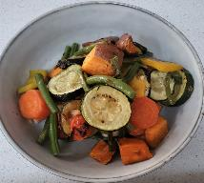
Roasted Vegetables
Serves 2 people
Preparation time = 5 minutes Cooking time = 40 minutes
Shopping List:
Store Cupboard
1 Teaspoon of oil
Equipment
Roasting Tray
Spatula
Sharp Knife
Chopping Board
Fresh
This works with any vegetables
Carrot
Sweet Potato / Potato
Butternut Squash
Courgette
Pepper
Green Beans

Slide 2
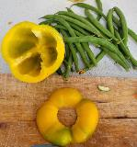
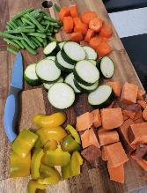
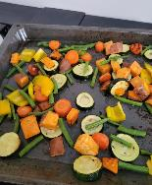
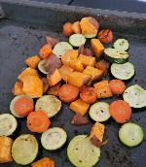
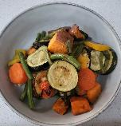
Method
Step 1 – Preheat oven to 190°C
Step 4 – Whilst this cooks, cut the pepper into chunks, remove the top and tail of the green beans and cut in half.
Picture
Step 2 – Peel the carrot. Then cut carrot, potatoes, courgette and squash into similar sized chunk’s- about 2cm. (No need to peel the potato or squash).
Step 5 – Add to the baking tray, mix and return to the over for 10 minutes.
Step 6 – Serve!
Step 3 – Place into baking tray and toss in the oil and sprinkle with dried herbs (if using).
Cook for 25 minutes.

