Slide 1
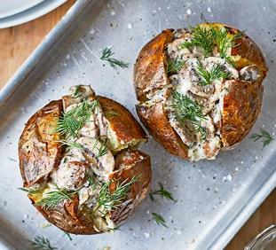
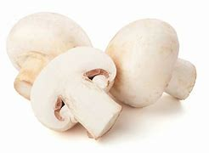
Vegetable of the Week: Mushroom
Different kinds of mushrooms are in season through different months of the year.
It is one of the few plant-based sources of Vitamin D. This is important for bone health and immune support.
Also contains selenium which prevents damage to cells and tissues.
Mushroom Jackets
Heat oven to 200C. Prick the jacket potato skins with a fork and rub with oil, bake for 1 hour.
Slice mushrooms, fry in oil and stir through sour cream & chive dip. Add to cooked jacket potatoes!
An 80g serving of mushrooms counts as 1 of your 5-a-day. This is approx. 14 button (small) mushrooms.

