Slide 1
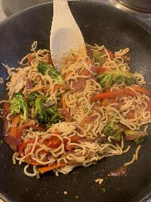
Vegetable Stir Fry
Serves 4 people
Preparation time = 8 minutes Cooking time = 10 minutes
Shopping List:
Store Cupboard
3 Teaspoons of oil
3 Teaspoons garlic granules
3 Tablespoons of soy sauce
3 Portions of soft noodles
6 Tablespoons of water
Fresh
4 Carrots
2 Bell peppers
½ Broccoli
2 Red onions
Equipment
Chopping Board
Sharp knife
Large frying pan
Wooden Spoon

Slide 2
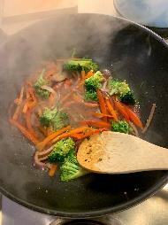
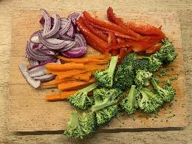
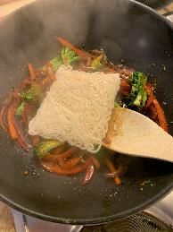
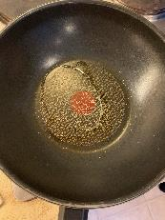
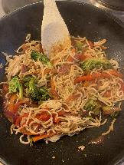
Method
Step 3 – Add the veg to the pan along with a dash of water and fry vegetables for 5-6 mins until soft, add soy sauce and another dash of water and cook for another 2 mins.
Step 1 – Chop all the vegetables into thin strips.
Step 4 – Add the noodles and give the food a good mix, add more water to avoid the food sticking to the pan. Fry until noodles have cooked through and the food is steaming hot.
Step 2 - Put the oil in a pan and gently cook for 2-3 minutes. Then add the garlic granules and vegetables.
Step 5 – Serve and enjoy!

